Slide 1
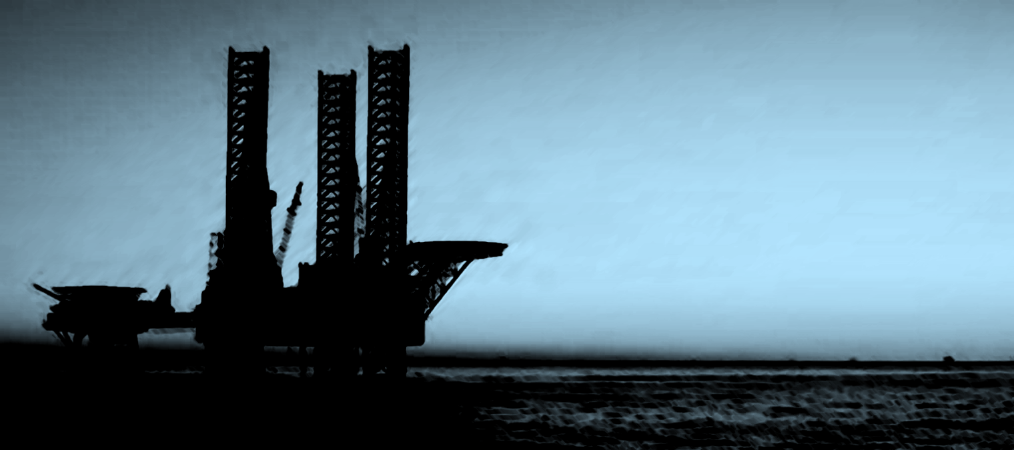
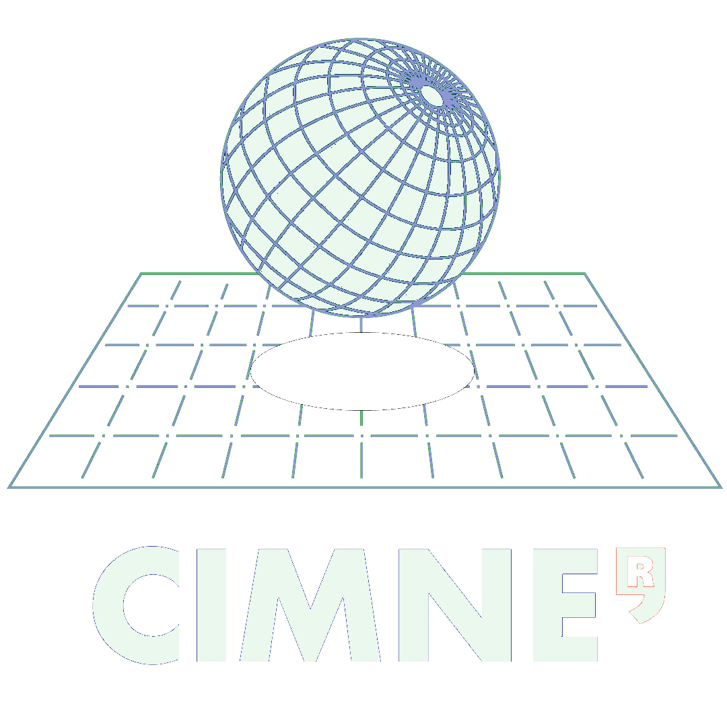

VI International Conference on
Computational Methods in Marine Engineering
Marine 2015
15 -17 June 2015, Rome Italy
Nonlinear Finite Element Analysis of Mooring Cables on Marine Structures
Gutiérrez-Romero, JE. García-Espinosa, J. Zamora-Parra, B. Esteve-Pérez JA.
COMPASS
WWW.COMPASSIS.COM
Universidad Politécnica de Cartagena

Slide 2
VI International Conference on
Computational Methods in Marine Engineering
Marine 2015
15 -17 June 2015, Rome Italy
Index
Introduction
Problem statement
Approach to coupling algorithm
Analysis examples
Conclusions

Slide 3
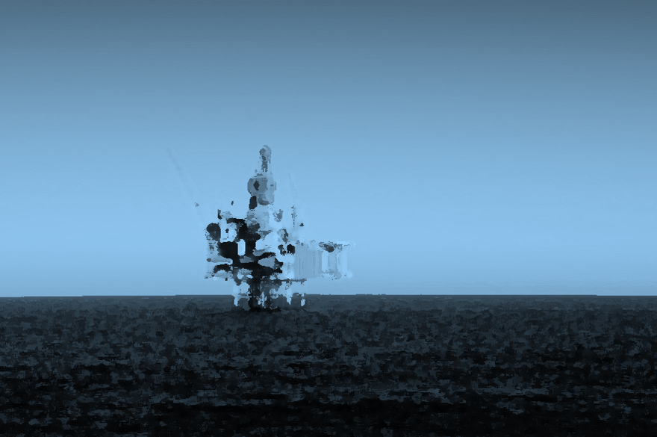
VI International Conference on
Computational Methods in Marine Engineering
Marine 2015
15 -17 June 2015, Rome Italy
1
Introduction

Slide 4
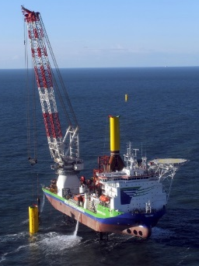
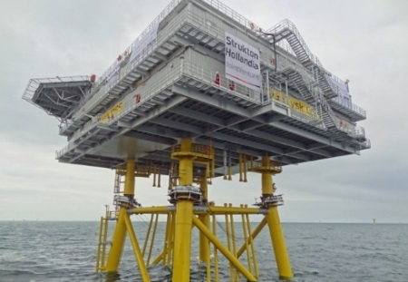
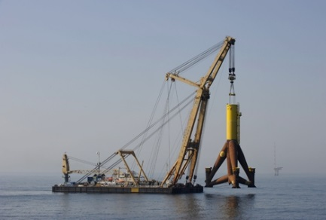
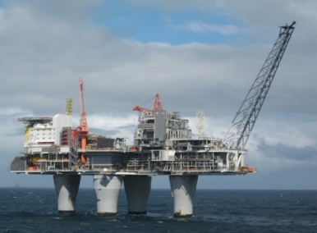
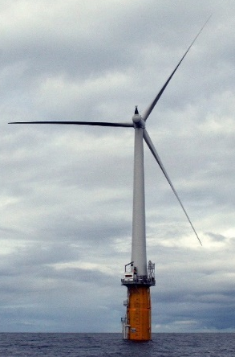
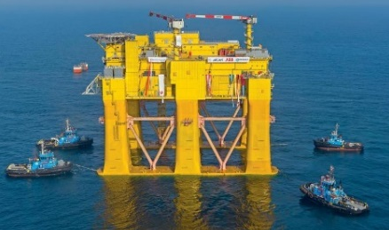
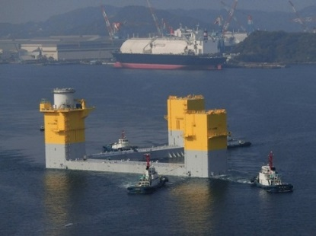
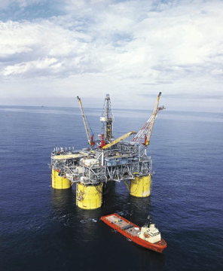
1. Introduction
VI International Conference on
Computational Methods in Marine Engineering
Marine 2015
15 -17 June 2015, Rome Italy
Main challenges of offshore industry/renewable energies are
Development of Deep water technology
Mooring and risers
Shallow water
Offshore wind market expansion
Deep water
Harsh environment
Variety of platforms

Slide 5
1. Introduction
VI International Conference on
Computational Methods in Marine Engineering
Marine 2015
15 -17 June 2015, Rome Italy
Coupling floater dynamics with environmental loads and external loads may be considered as key in realistic simulations.
Marine cable structures has reached great interest
Wide range of application
Great importance in offshore production system
Classical solutions give unrealistic solution
Cable solutions approach has been compared:
  Linear spring
  Nonlinear spring
  Quasi-static solution
  FEM solution
  Nonlinear FEM solution
Authors presents in this work an application to couple NFEM cable model with second - order wave and wind loads.
Nonlinear wave loads
Nonlinear mooring loads
Nonlinear wind loads

Slide 6
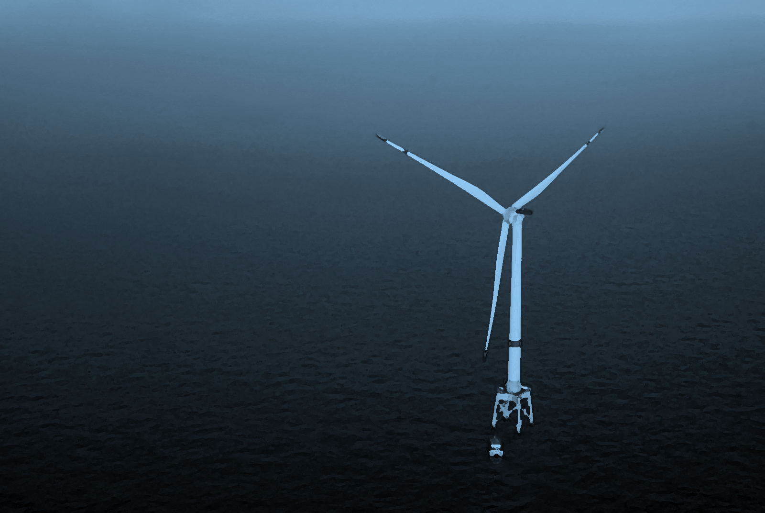
VI International Conference on
Computational Methods in Marine Engineering
Marine 2015
15 -17 June 2015, Rome Italy
2
Problem statement

Slide 7





2. Problem statement
VI International Conference on
Computational Methods in Marine Engineering
Marine 2015
15 -17 June 2015, Rome Italy
Cable dynamics:
$$m\left(\frac{∂u}{∂s}−v\frac{∂φ}{∂t}\right)=\frac{∂T}{∂s}−w_{0}\sin{φ}−\frac{∂φ}{∂s}\left(EI\frac{∂^{2}φ}{∂s^{2}}\right)−f_{x}$$
$$m\left(\frac{∂v}{∂s}−u\frac{∂φ}{∂t}\right)+m_{a}\frac{∂v}{∂t}=\frac{∂}{∂s}\left(EI\frac{∂^{2}φ}{∂s^{2}}\right)+T\frac{∂φ}{∂s}−w_{0}\cos{φ}−f_{y}$$
$$\frac{∂T}{∂t}=EA\left(\frac{∂u}{∂s}−v\frac{∂φ}{∂s}\right)$$
The mathematical model considers:
Self weight
Hydrostatics loads
Drag loads
Viscous loads
Seabed interaction
Geometric nonlinearities
Most cases, the bending and the torsion effects are negligible. The set of last equations can be formulated as
$$\frac{∂φ}{∂t}=\frac{∂v}{∂s}−u\frac{∂φ}{∂s}$$
$$\left(ρ_{w}C_{m}A+ρ\right)\frac{∂^{2}r}{∂t^{2}}=\frac{∂}{∂s}\left(EA\frac{e}{e+1}\frac{∂r}{∂s}\right)+f\left(t\right)\left(1+e\right)$$

Slide 8


2. Problem statement
VI International Conference on
Computational Methods in Marine Engineering
Marine 2015
15 -17 June 2015, Rome Italy
Spatial discretization of cable element. Time integration
Applying FEM on current configuration of cable element the balance of momentum can be formulated as
$$\sum_{e=1}^{n}{Z_{e}^{T}\int_{V}{ρH^{T}H Z_{e}dV·\ddot{r}}}=\sum_{e=1}^{n}{Z_{e}^{T}\int_{V_{e}}{ρH^{T}g dV}}+\sum_{e=1}^{n}{Z_{e}^{T}\int_{S_{e}}{ρH^{T}t dS}}−\sum_{e=1}^{n}{Z_{e}^{T}\int_{V_{e}}{B^{T}σ dS}}$$
Time integration using Bossak-Newmark scheme
Aitken acceleration method
$$M\ddot{r}=f_{ext}−f_{int}$$
The dynamic equilibrium in current configuration of an element can be written:
$$f_{ext}^{t+Δt}=M^{t+Δt} \ddot{r}+C^{t+Δt} \dot{r}+{\left(K_{L}+K_{NL}\right)}^{t+Δt} δr+P^{0}+f_{int}^{t}$$
$$\left[\left(1−α_{b}\right)M^{t+Δt,i}+Δt γC^{t+Δt,i}+Δt^{2}β\left({\left(K_{L}+K_{NL} \right)}^{t+Δt,i}\right)\right]{\ddot{r}}^{t+Δt,i+1}=$$
$$Δt^{2}β\left({\left(K_{L}+K_{NL} \right)}^{t+Δt,i}\right){\ddot{r}}^{t+Δt,i}+f_{ext}^{t+Δt, i}−P^{0}−f_{int}^{t+Δt,i}$$
$−C^{t+Δt,i}\left[{\dot{r}}^{t}−Δt\left(γ+1\right){ \dot{r}}^{t}\right]−σ_{b}M^{t+Δt} {\ddot{r}}^{t}$

Slide 9





2. Problem statement
VI International Conference on
Computational Methods in Marine Engineering
Marine 2015
15 -17 June 2015, Rome Italy
Seakeeping solver. SeaFEM
Seakeeping solver based on previous work of García-Espinosa and Serván-Camas.
SeaFEM includes state-of-the-art radiation and diffraction BEM and FEM solvers, enabling frequency domain and direct time-domain analyses of the dynamic response of the structure.
$$Δφ=0 on Ω$$
1st and 2nd Stokes regular and spectral waves, including user
defined spectrum. 1st and 2nd solution can be decomposed on:
  Incident wave potential and diffraction - radiation velocity potential
  Incident wave elevation and diffraction –radiation wave elevation
$$\frac{∂ξ}{∂t}−\frac{∂ξ}{∂z}=−\frac{∂φ}{∂x}\frac{∂ξ}{∂x}−\frac{∂φ}{∂y}\frac{∂ξ}{∂y} on z=0$$
$$\frac{∂φ}{∂t}+\frac{P_{fs}}{ρ}+gξ=−\frac{1}{2}∇φ·∇φ on z=ζ$$
Solve using FEM on unstructured meshes
Real forward speed with Streamline & SPUG integration
GPU computing
Hydro-elasticity solver for strength and fatigue assessment
$$V_{φ} n=−V_{b}n on Γ_{b}$$
$$\frac{P_{b}}{ρ}=−gz_{b}−\frac{∂φ}{∂t}−\frac{1}{2}∇φ·∇φ on Γ_{b}$$

Slide 10
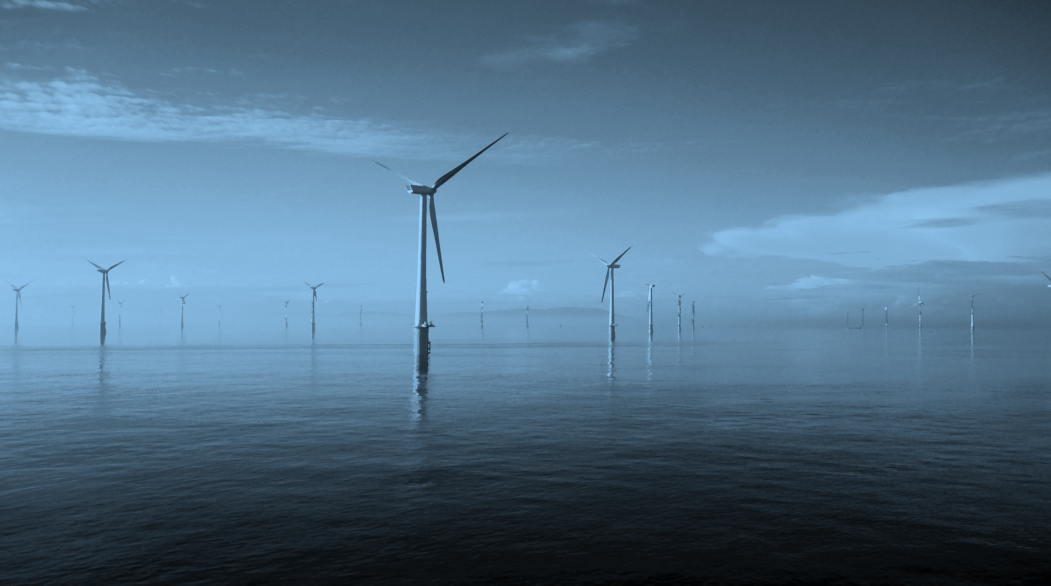
VI International Conference on
Computational Methods in Marine Engineering
Marine 2015
15 -17 June 2015, Rome Italy
3
Coupling rigid body motions & external loads

Slide 11











2. Coupling Rigid body motion & external loads
VI International Conference on
Computational Methods in Marine Engineering
Marine 2015
15 -17 June 2015, Rome Italy
Time-marching loop (n)
$$F_{0}^{n,0,0}=F_{0}^{n−1}$$
$$F_{H}^{n,0}=F_{H}^{n−1}$$
$${\overset{̿}{\text{K}}}_{M}^{n,0}X^{n,0,0}={\overset{̿}{\text{K}}}_{M}^{n−1}X^{n−1}$$
Solver loop (k)
Once the velocity potential has been estimated in the current time step, a loop to determine the dynamics of floater is launched.
Then, the pressure on the wetted surface of the floating device is calculated and the different external forces and moments acting on the floater are evaluated.
The new position of the floater for the l-iteration of the iterative loop is obtained adding the restoring force vector of mooring cables.
The fairlead position of the cable is updated. Then, the dynamics of cable is calculated. The stiffness matrix of the different lines is evaluated by numerical differentiation. For every l-iteration of the floater dynamics loop, the restoring mooring forces are evaluated.
A new l+1+iteration from step 2 to 5 is carried out, until the convergence of the floater dynamics loop is reached.
Once the floater dynamics obtaining has converged, a new k+1-iteration of the velocity potential loop is done until convergence. When the convergence of this loop has been achieved, a new time step solution is initiated.
Body dynamics loop (l)
Solve:
$$\overset{̿}{\text{M}}{\ddot{X}}^{n,k,l}=F_{}^{n,k,l}$$
$$F_{}^{n,k,l}=F_{0}^{n,k−1,l−1}+F_{H}^{n,k−1}−{\overset{̿}{\text{K}}}_{M}^{n,k−1}X^{n,k−1,l−1}$$
Calculate: ${{\dot{X}}^{n,k,l}; X}^{n,k,l}$
$$l=l+1$$
$$k=k+1$$
Convergence:
$$\left\|X^{n,k,l}−X^{n,k,l−1}\right\|<ε_{l}$$
No
Update:
$$F_{0}^{n,k,l}\left(X^{n,k,l},{\dot{X}}^{n,k,l},{\ddot{X}}^{n,k,l}\right)$$
Yes
Convergence:
$$\left\|X^{n,k}−X^{n,k−1}\right\|<ε_{k}$$
No
Calculus: ${\overset{̿}{\text{K}}}_{M}^{n,k}\left(X^{n,k}\right)$; $F_{H}^{n,k}\left(X^{n,k},{\dot{X}}^{n,k}\right)$
Yes
$$n=n+1; k=1; l=1$$

Slide 12
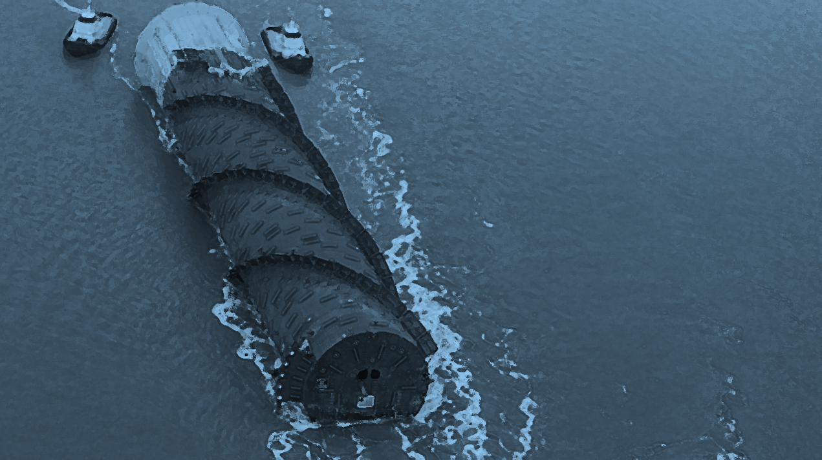
VI International Conference on
Computational Methods in Marine Engineering
Marine 2015
15 -17 June 2015, Rome Italy
4
Application examples

Slide 13
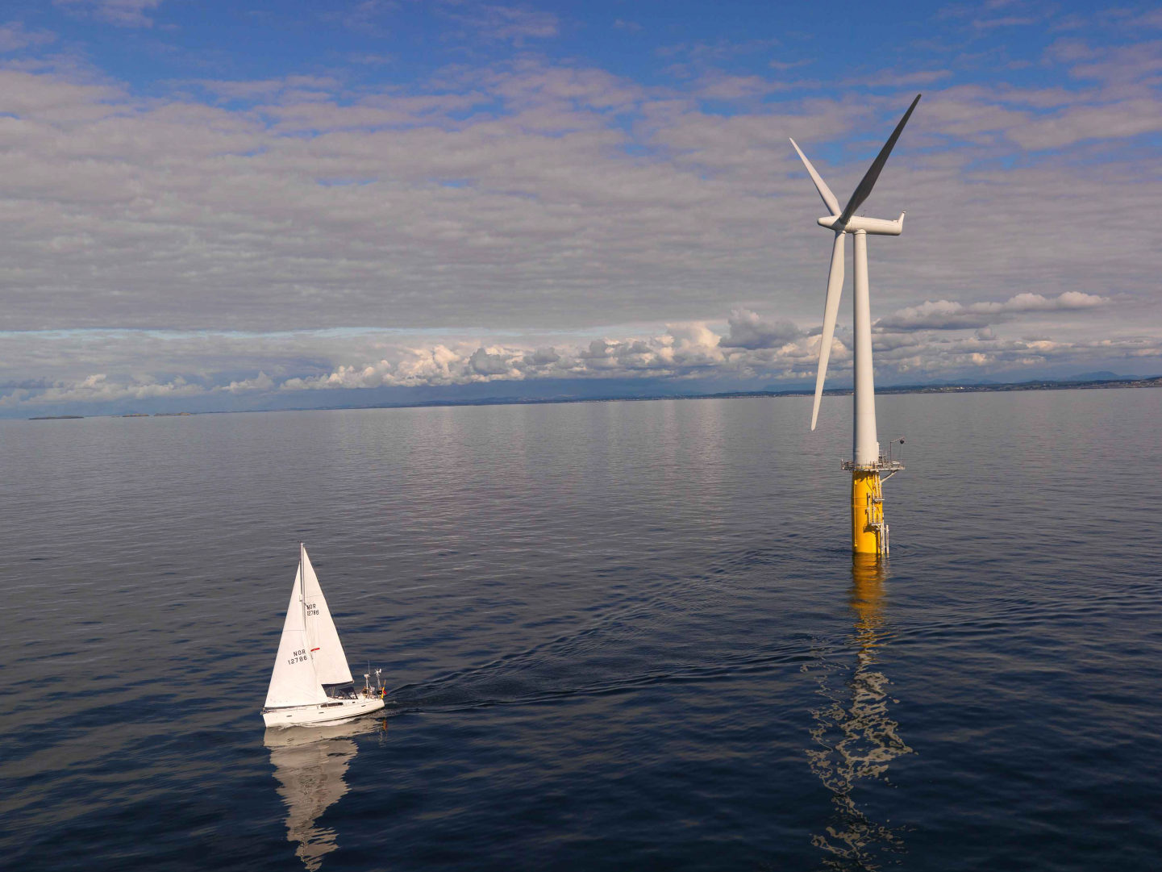
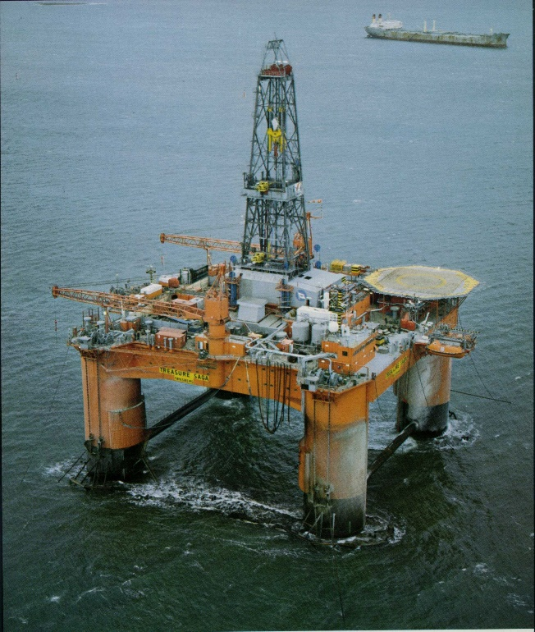
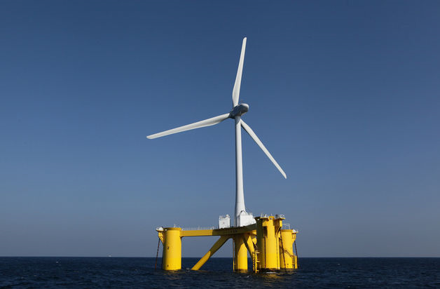
4. Application examples
VI International Conference on
Computational Methods in Marine Engineering
Marine 2015
15 -17 June 2015, Rome Italy

Slide 14
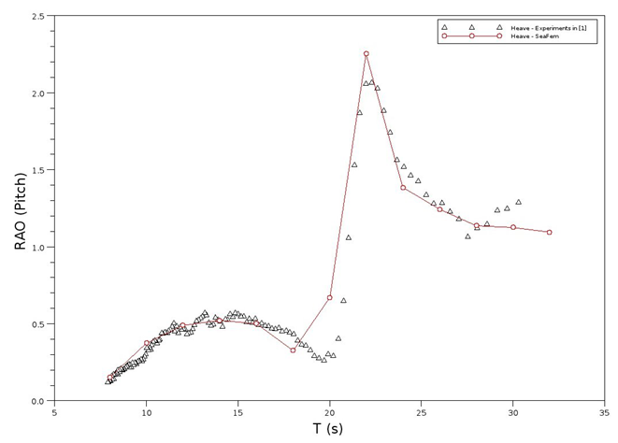
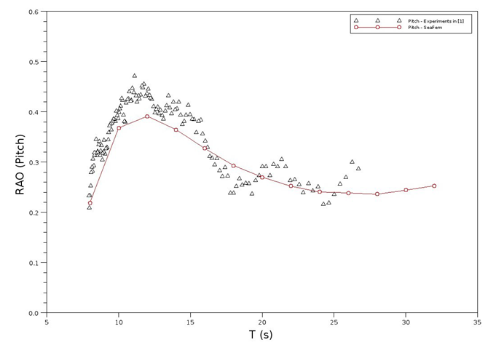
4. Application examples
VI International Conference on
Computational Methods in Marine Engineering
Marine 2015
15 -17 June 2015, Rome Italy
GVA platform analysis
RAO validation
Main particulars:
Displacement (ton) | 25940
Center of gravity above keel (m) | 21.35
Radii of inertia R_{xx} (m) | 30.40
Radii of inertia R_{yy} (m) | 31.06
Radii of inertia R_{zz} (m) | 37.54

Slide 15
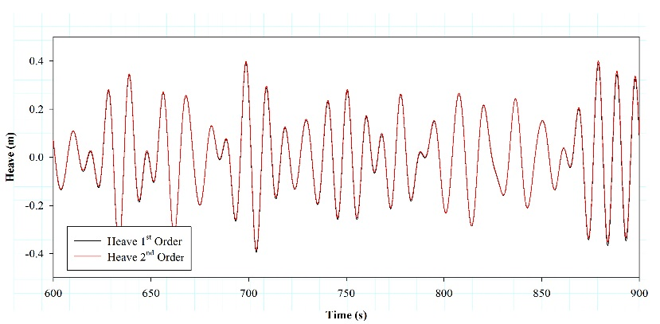
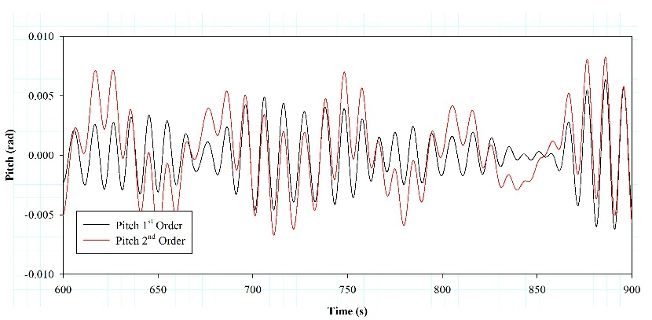

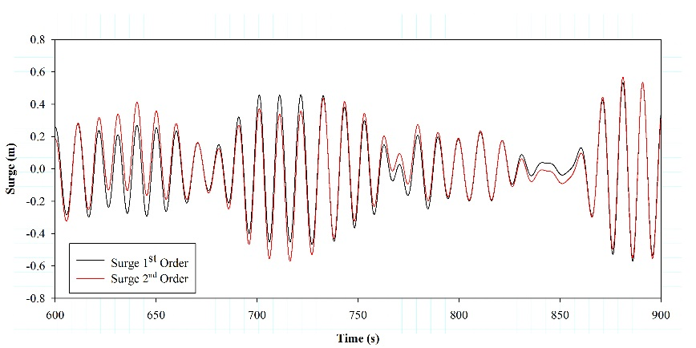
4. Application examples
VI International Conference on
Computational Methods in Marine Engineering
Marine 2015
15 -17 June 2015, Rome Italy
GVA 4000 platform analysis
Wave spectrum: JONSWAP
Peak period: 7.7 s
Significant wave height: 3.0 m
Number of mooring lines: 8
Stiffness: 3.84x107 N
Length of lines: 520.0 m
Weight per unit length: 698.1 N/m
Nº of elements/line: 100
 | Surge (m) | Sway (m) | Heave (m) | Roll (º) | Pitch (º) | Yaw (º)
Mean 1st | -0.01 | 0.00 | 0.00 | 0.00 | 0.00 | 0.00
Mean 2nd | 0.55 | 0.01 | 0.01 | 0.06 | 0.06 | -0.03
Amplitude 1st | 1.20 | 0.12 | 1.44 | 0.39 | 1.37 | 0.17
Amplitude 2nd | 4.87 | 0.59 | 1.48 | 2.19 | 2.09 | 0.80
RMS 1st | 0.17 | 0.02 | 0.21 | 0.07 | 0.22 | 0.03
RMS 2nd | 1.10 | 0.10 | 0.21 | 0.37 | 0.36 | 0.16
Low amplitude of heave motion
Low amplitude rotations

Slide 16
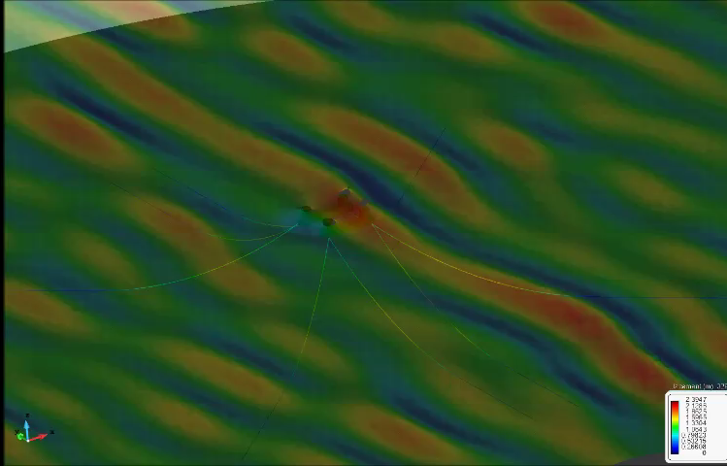
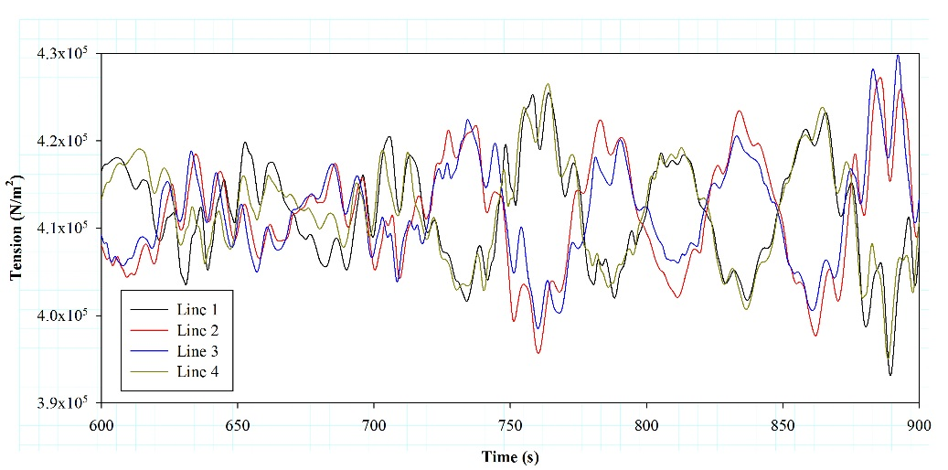
4. Application examples
VI International Conference on
Computational Methods in Marine Engineering
Marine 2015
15 -17 June 2015, Rome Italy
GVA 4000 platform analysis
 | Max. (10⁵ N) | Min. (10⁵ N) | Mean (10⁵ N) | RMS (10⁵ N)
Line 1 | 4.309 | 3.930 | 4.118 | 4.119
Line 2 | 4.308 | 3.908 | 4.117 | 4.118
Line 3 | 4.305 | 3.922 | 4.118 | 4.118
Line 4 | 4.3195 | 3.934 | 4.118 | 4.119
Mooring tensions ≈ line weight
In general, good response in operating conditions
But noticeable peaks are identified in the time series …

Slide 17
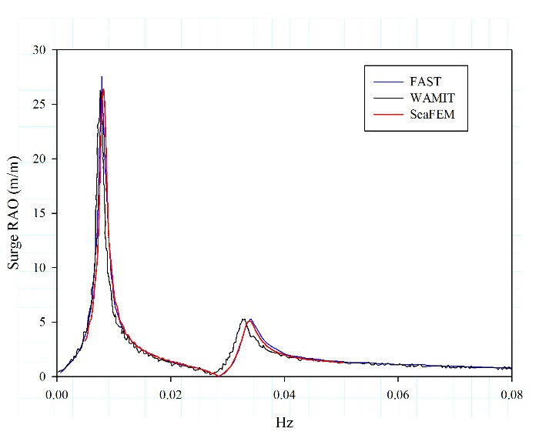

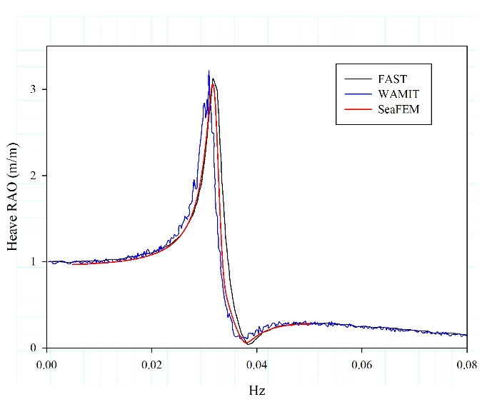
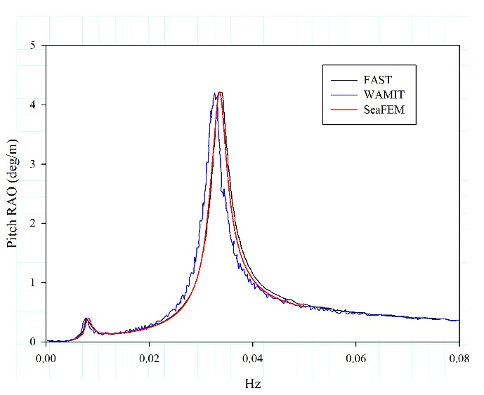
4. Application examples
VI International Conference on
Computational Methods in Marine Engineering
Marine 2015
15 -17 June 2015, Rome Italy
Spar OC3 fully analysis
RAO validation
Main particulars:
Displacement (ton) | 8163.76
Center of gravity below SWL (m) | -75.098
Radii of inertia R_{xx} (m) | 49.41
Radii of inertia R_{yy} (m) | 49.48
Radii of inertia R_{zz} (m) | 5.64

Slide 18
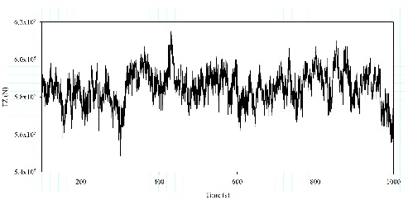
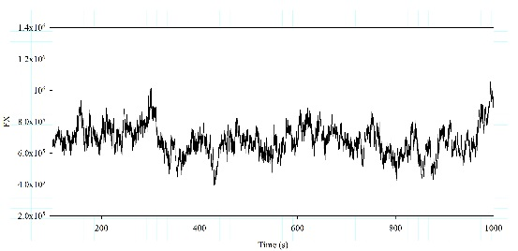
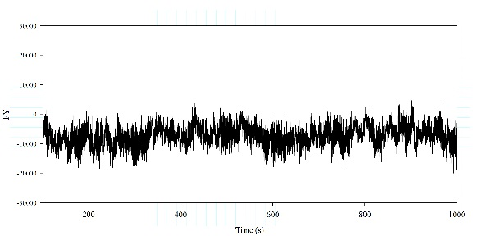
4. Application examples
VI International Conference on
Computational Methods in Marine Engineering
Marine 2015
15 -17 June 2015, Rome Italy
Spar OC3 fully analysis
Time – Domain Analysis
Wave spectrum: JONSWAP
Peak period: 12 s
Significant wave height: 6.0 m
Mean Wind velocity: 11.4 m
Number of mooring lines: 3
Stiffness: 6.04x10¹⁰ N
Length of lines: 902 m
Weight per unit length: 698.1 N/m
Nº of elements/line: 200
Wind turbine: Linearized model (operating condition). FASTLognoter
Wind profile: coupling with AeroDyn (time history loads)
Waves: FEM hydrodynamics model
(1st & 2nd ) + JONSWAP spectrum
Mooring: Nonlinear FEM cable model
Wind Loads

Slide 19
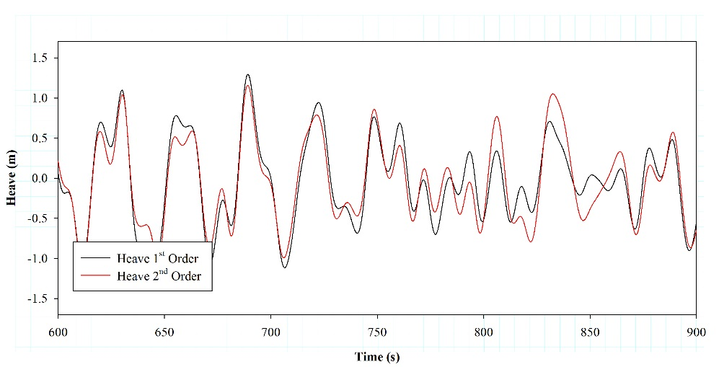

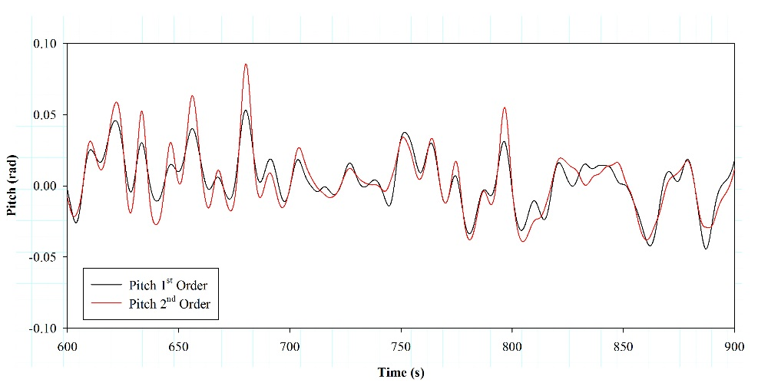
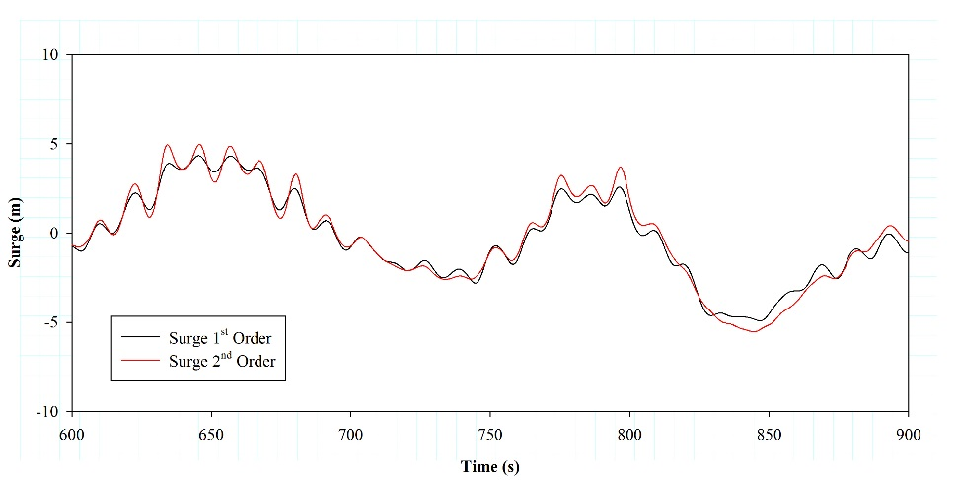
4. Application examples
VI International Conference on
Computational Methods in Marine Engineering
Marine 2015
15 -17 June 2015, Rome Italy
Spar OC3 fully analysis
Similar trends between First and Second-Order wave environment
Higher amplitudes on pitch motion
Excursions on surge
 | Surge (m) | Sway (m) | Heave (m) | Roll (º) | Pitch (º) | Yaw (º)
Mean 1st | -0.01 | 0.00 | -0.01 | 0.29 | 0.40 | 0.21
Mean 2nd | 0.10 | 0.00 | -0.03 | 0.30 | 0.42 | 0.28
Amplitude 1st | 13.82 | 1.12 | 2.61 | 1.92 | 6.03 | 10.31
Amplitude 2nd | 15.19 | 1.55 | 2.59 | 2.02 | 8.00 | 10.83
RMS 1st | 2.54 | 0.18 | 0.50 | 0.52 | 1.09 | 1.09
RMS 2nd | 2.73 | 0.24 | 0.45 | 0.48 | 1.22 | 1.91

Slide 20
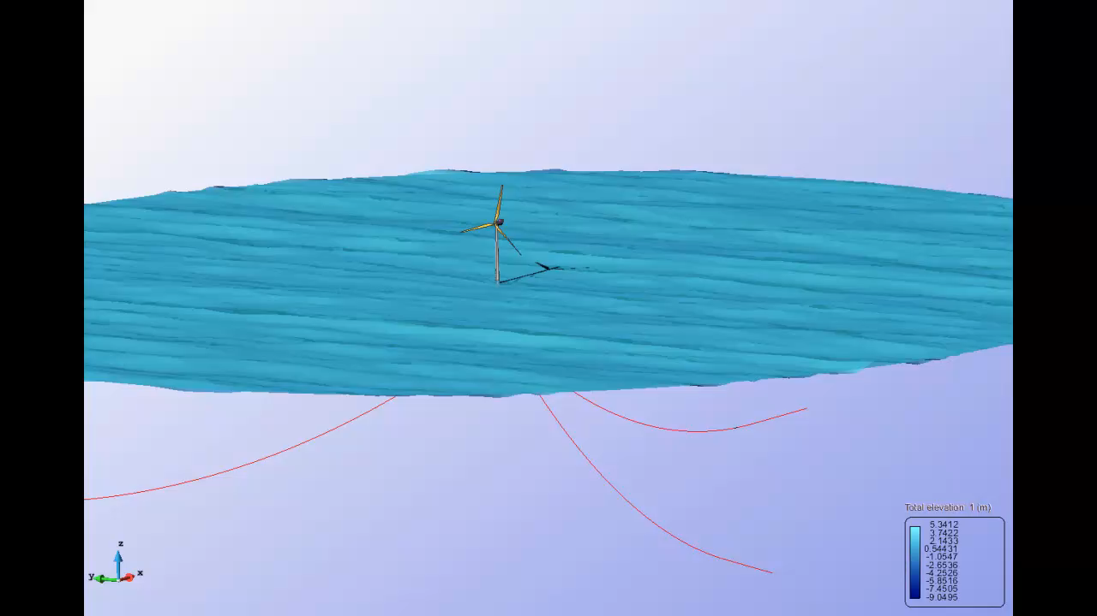
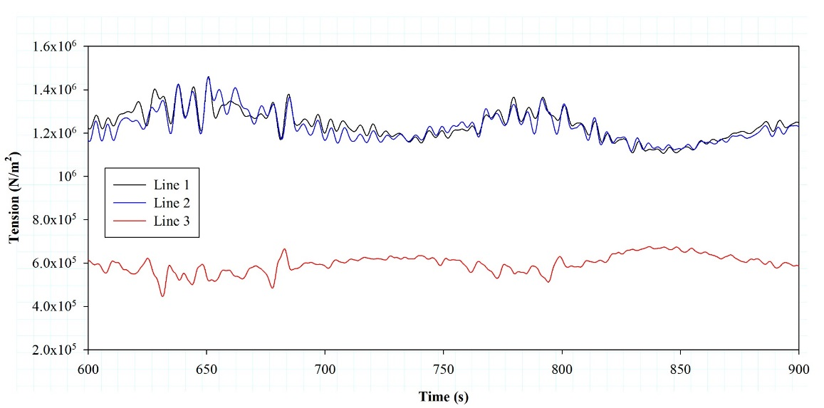
4. Application examples
VI International Conference on
Computational Methods in Marine Engineering
Marine 2015
15 -17 June 2015, Rome Italy
Spar OC3 fully analysis
One line supports main environmental loads
Good performance in operational conditions
 | Max. (10⁶ N) | Min. (10⁶ N) | Mean (10⁶ N) | RMS (10⁶ N)
Line 1 | 1.457 | 1.052 | 1.246 | 1.248
Line 2 | 1.471 | 1.040 | 1.236 | 1.238
Line 3 | 0.742 | 0.451 | 0.593 | 0.954

Slide 21
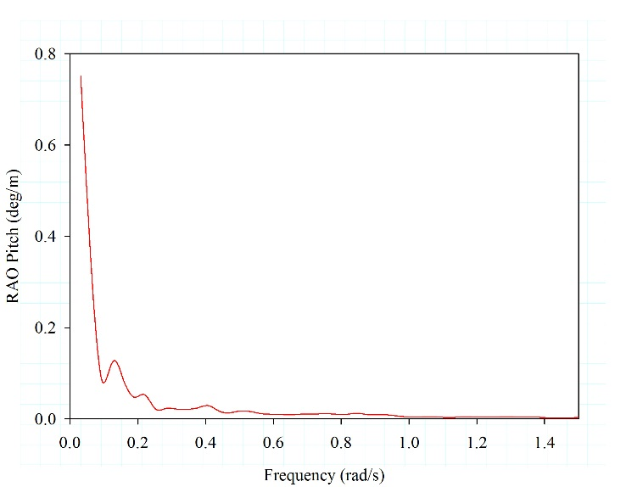
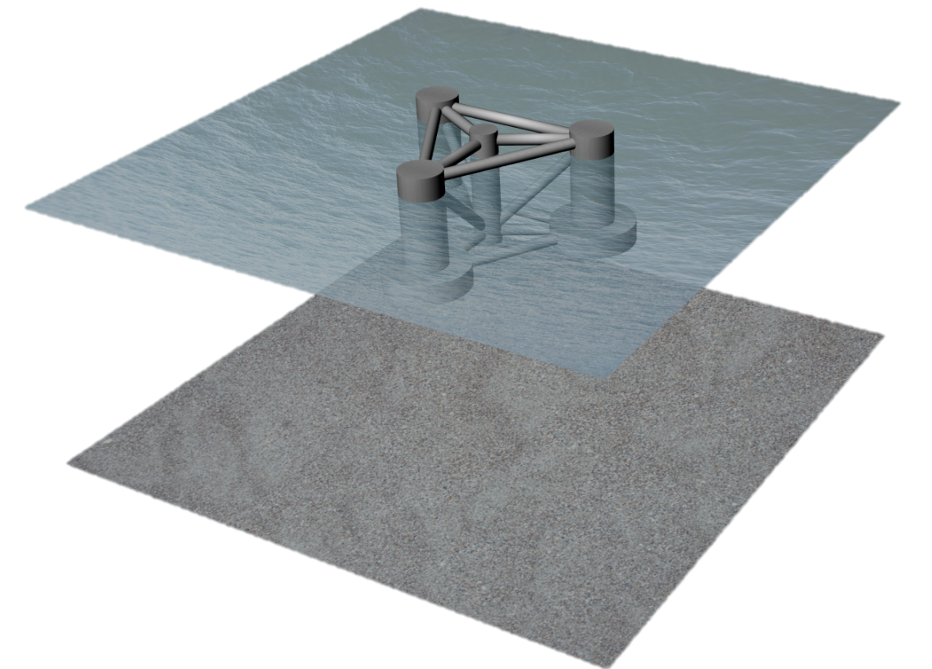
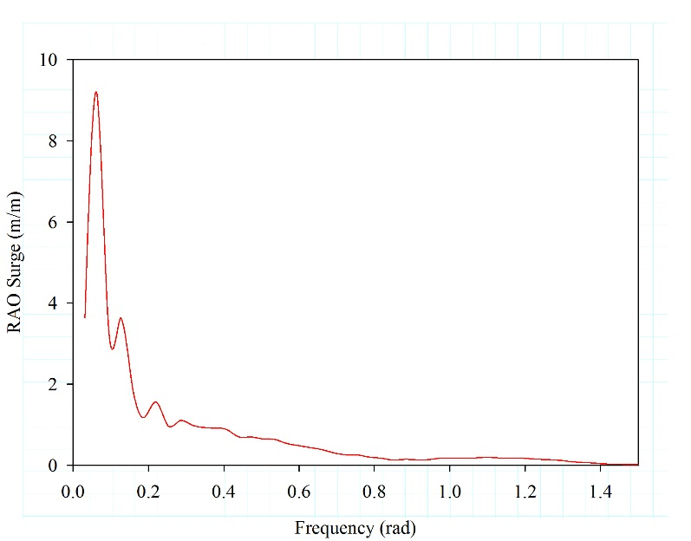
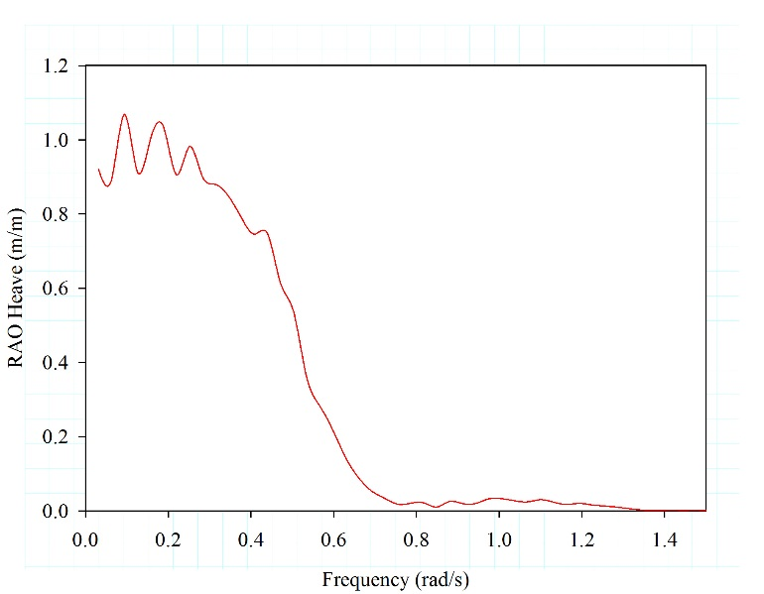
4. Application examples
VI International Conference on
Computational Methods in Marine Engineering
Marine 2015
15 -17 June 2015, Rome Italy
Semisubmersible OC4 fully analysis
RAO analysis
Main particulars:
Displacement (ton) | 13473
Center of gravity below SWL (m) | -9.205
Radii of inertia R_{xx} (m) | 29.21
Radii of inertia R_{yy} (m) | 29.21
Radii of inertia R_{zz} (m) | 30.59

Slide 22
4. Application examples
VI International Conference on
Computational Methods in Marine Engineering
Marine 2015
15 -17 June 2015, Rome Italy
Semisubmersible OC4 fully analysis
Time – Domain Analysis
Wave spectrum: JONSWAP
Peak period: 12 s
Significant wave height: 6.0 m
Mean Wind velocity: 11.4 m
Number of mooring lines: 3
Stiffness: 1.63x10¹¹ N
Length of lines: 835.5 m
Weight per unit length: 1066.0 N/m
Nº of elements/line: 200
Wind turbine: Linearized model (operating condition). FASTLognoter
Wind profile: coupling with AeroDyn (time history loads)
Wind Loads
Waves: FEM hydrodynamics model
(1st & 2nd ) + JONSWAP spectrum
Mooring: Nonlinear FEM cable model

Slide 23
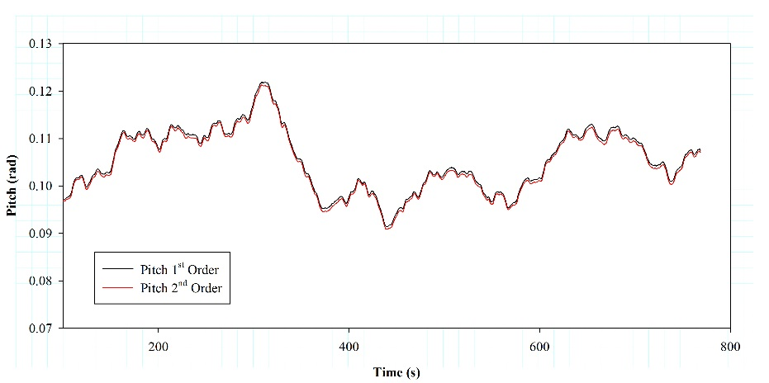
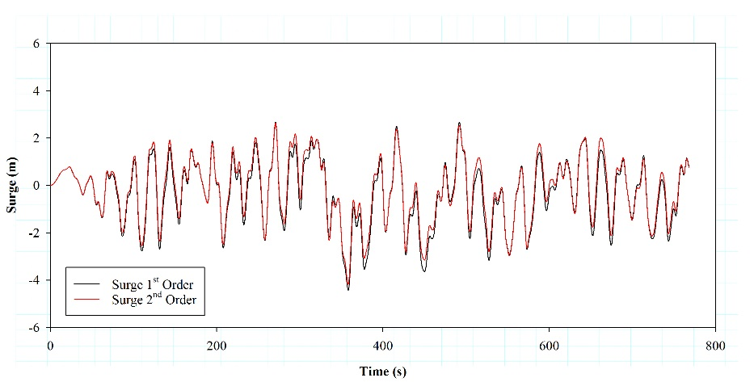
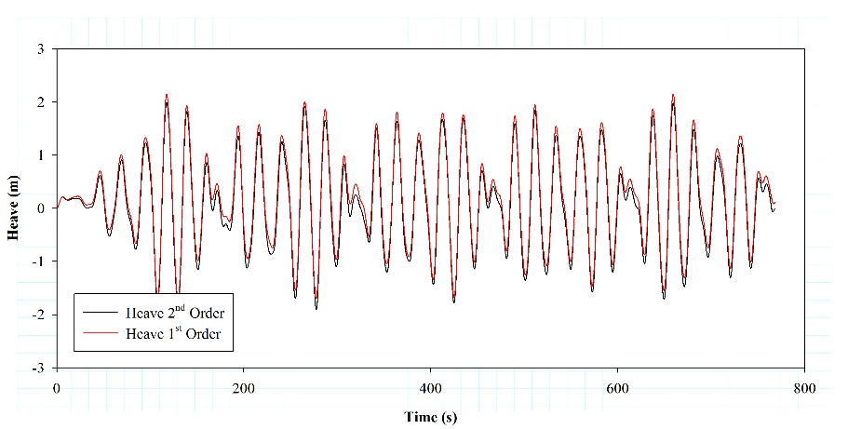
4. Application examples
VI International Conference on
Computational Methods in Marine Engineering
Marine 2015
15 -17 June 2015, Rome Italy
Semisubmersible OC4 fully analysis
 | Surge (m) | Sway (m) | Heave (m) | Roll (rad) | Pitch (rad) | Yaw (rad)
Mean 1st | -0.34 | -0.71 | 0.22 | 0.01 | 0.10 | 0.00
Mean 2nd | -0.19 | -0.72 | 0.08 | 0.01 | 0.10 | 0.00
Amplitude 1st | 7.10 | 1.21 | 3.86 | 0.01 | 0.12 | 0.01
Amplitude 2nd | 6.81 | 1.22 | 3.89 | 0.01 | 0.12 | 0.01
RMS 1st | 1.40 | 0.75 | 0.90 | 0.01 | 0.10 | 0.00
RMS 2nd | 1.33 | 0.76 | 0.88 | 0.01 | 0.10 | 0.00
Similar trends between First and Second-Order wave environment
Higher amplitudes on pitch motion
Excursions on surge

Slide 24
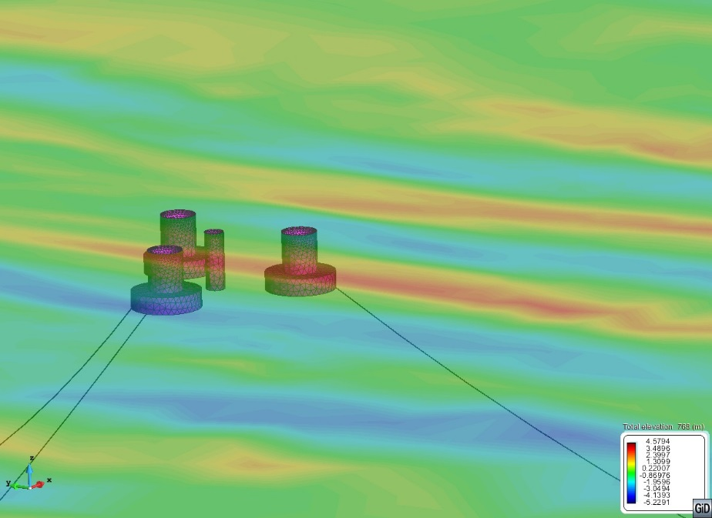
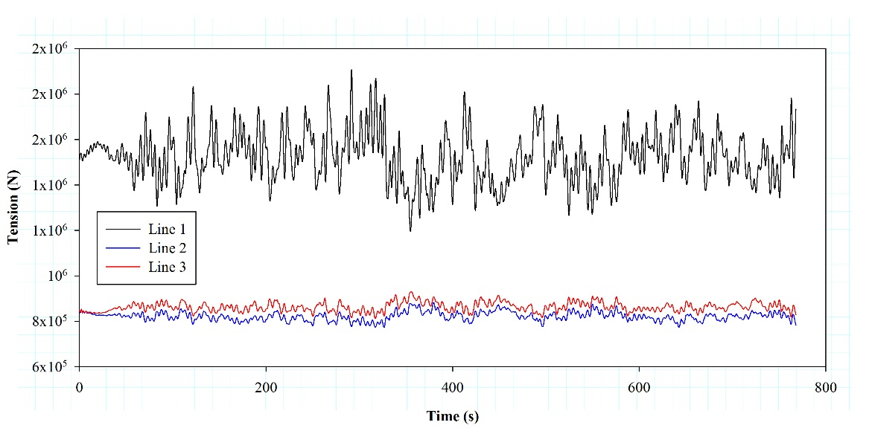
4. Application examples
VI International Conference on
Computational Methods in Marine Engineering
Marine 2015
15 -17 June 2015, Rome Italy
Semisubmersible OC4 fully analysis
 | Max. (10⁶ N) | Min. (10⁶ N) | Mean (10⁶ N) | RMS (10⁶ N)
Line 1 | 1.522 | 1.198 | 1.884 | 1.526
Line 2 | 0.823 | 0.775 | 0.880 | 0.823
Line 3 | 0.864 | 0.813 | 0.930 | 0.864
One line supports main environmental loads
Good performance in operational conditions

Slide 25
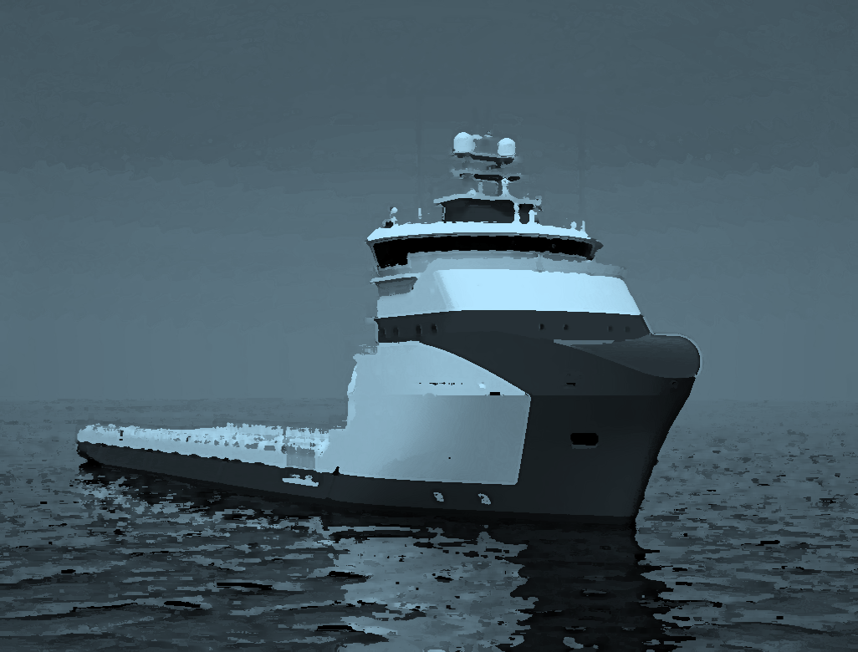
VI International Conference on
Computational Methods in Marine Engineering
Marine 2015
15 -17 June 2015, Rome Italy
5
Conclusions

Slide 26
5. Conclusions
VI International Conference on
Computational Methods in Marine Engineering
Marine 2015
15 -17 June 2015, Rome Italy
Seakeeping model for solving the governing equations for second-order wave diffraction-radiation problem.
An introduction to cable dynamic formulation has been described.
Formulation based on Nonlinear FEM dynamic cable model to solve realistic problems has been presented.
A scheme for the fully coupled analysis of a floating structure and nonlinear external loads.
Fully coupled formulation to determine the dynamic behaviour of three representative examples of offshore structures has been performed.

Slide 27
VI International Conference on
Computational Methods in Marine Engineering
Marine 2015
15 -17 June 2015, Rome Italy
Thanks for your attention!
Nonlinear Finite Element Analysis of Mooring Cables on Marine Structures
Corresponding Author:
jose.gutierrez@upct.es
COMPASS
WWW.COMPASSIS.COM
Universidad Politécnica de Cartagena

